Slide 1
Experimental Aeroacoustics
Lecture 3.3
Propeller and Propfan Noise

Slide 2
Module content
Propeller sources of noise
Harmonic, unsteady and random components
Harmonic noise prediction
Extension to contra-rotating propeller

Slide 3
Learning objectives
Understand what the sources of propeller noise are
Be able to differentiate between thickness noise, loading noise and non-linearities
Understand the procedure to predict noise in multiple propellers
Sketch the procedure to predict noise in more complex configurations

Slide 4
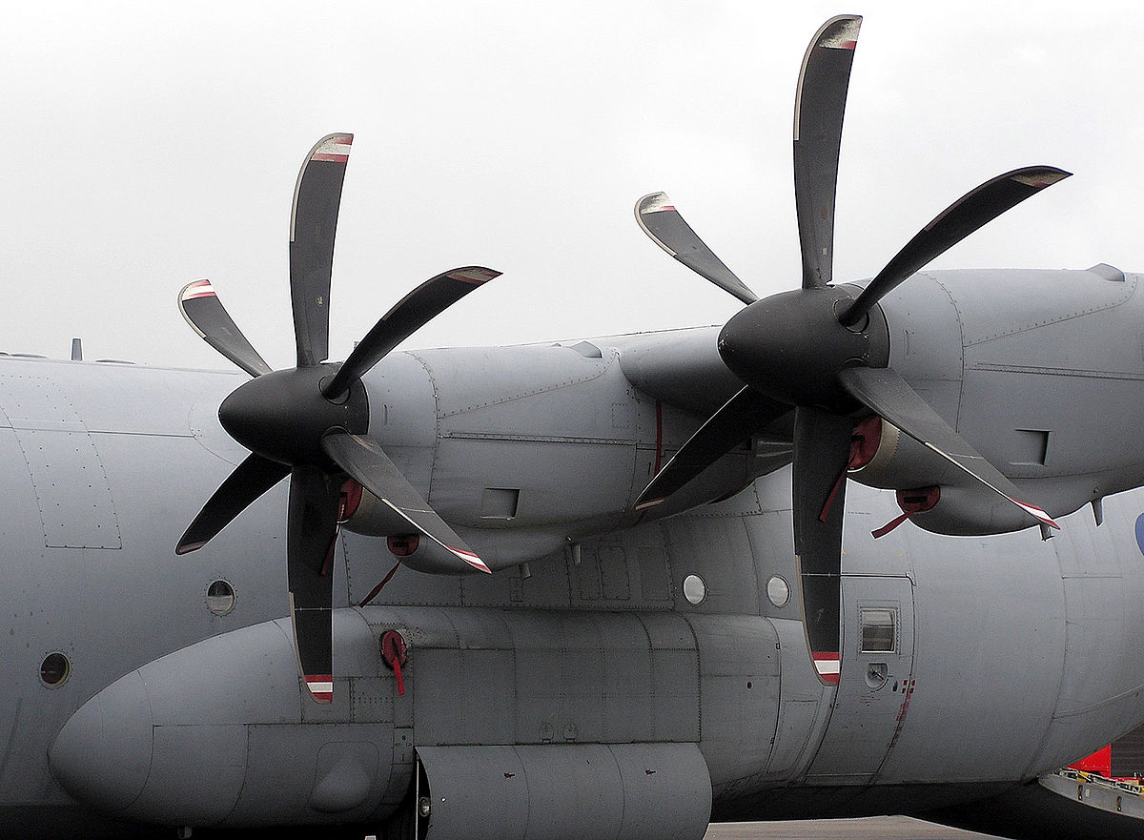
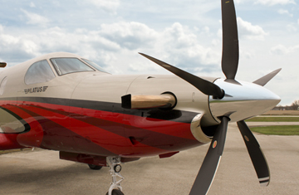
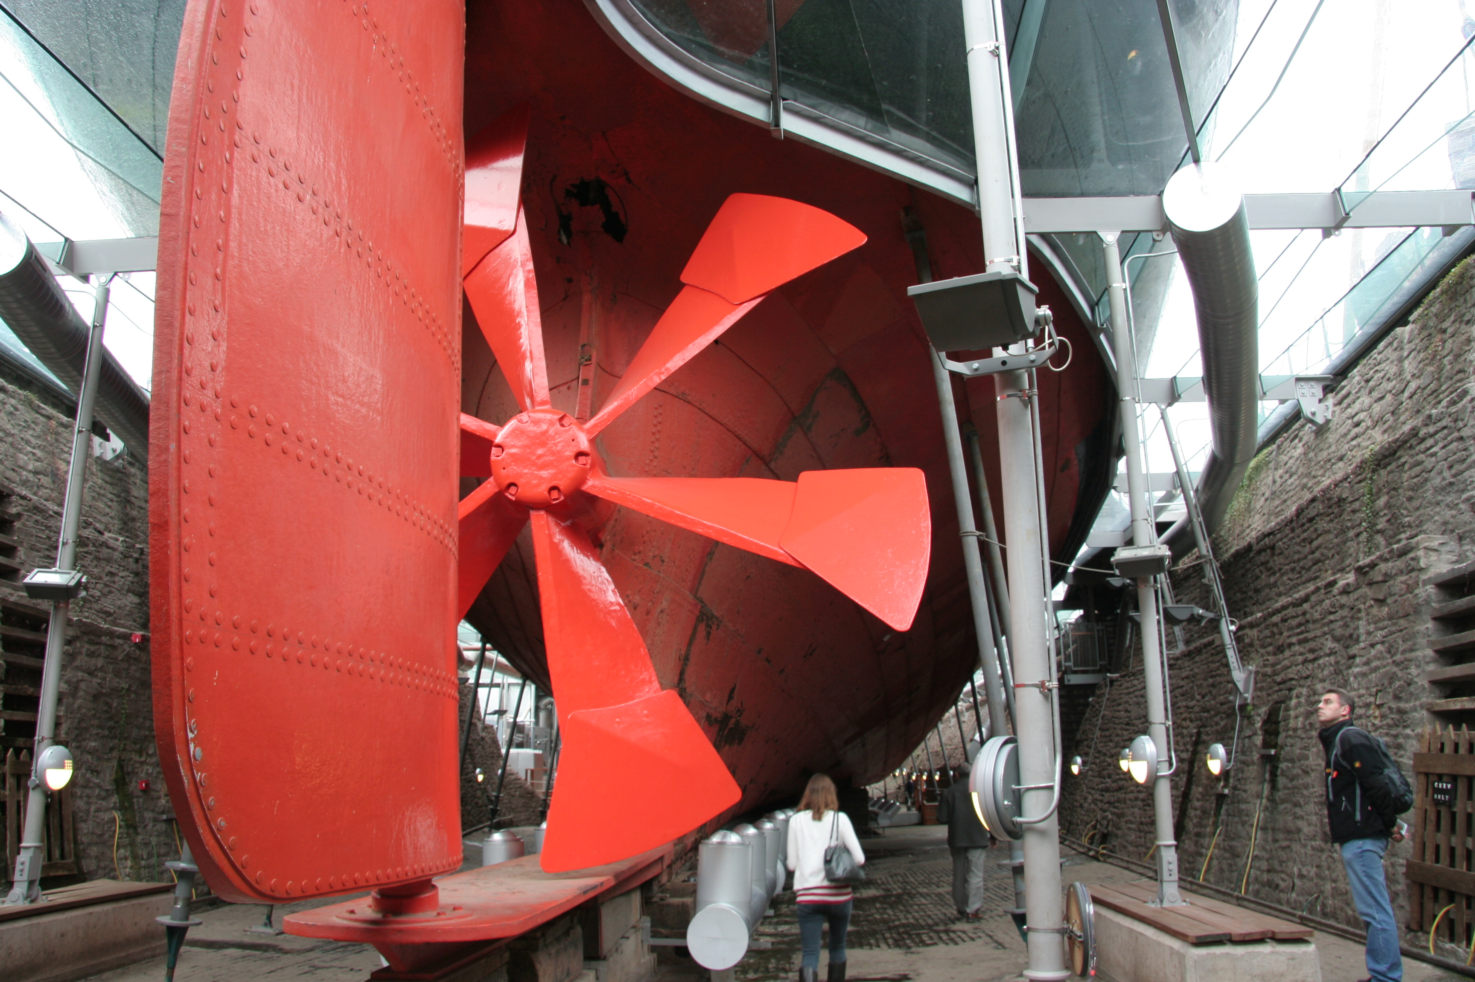
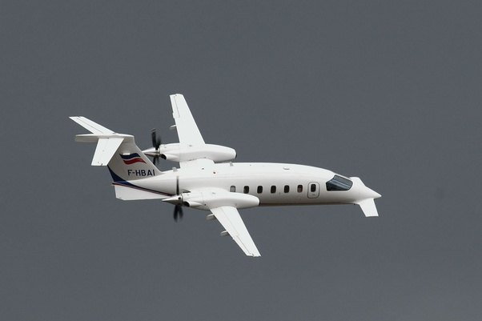
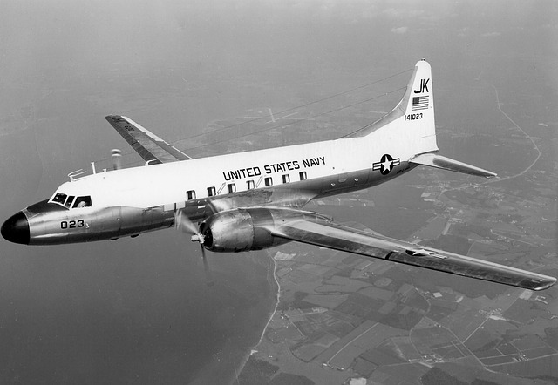
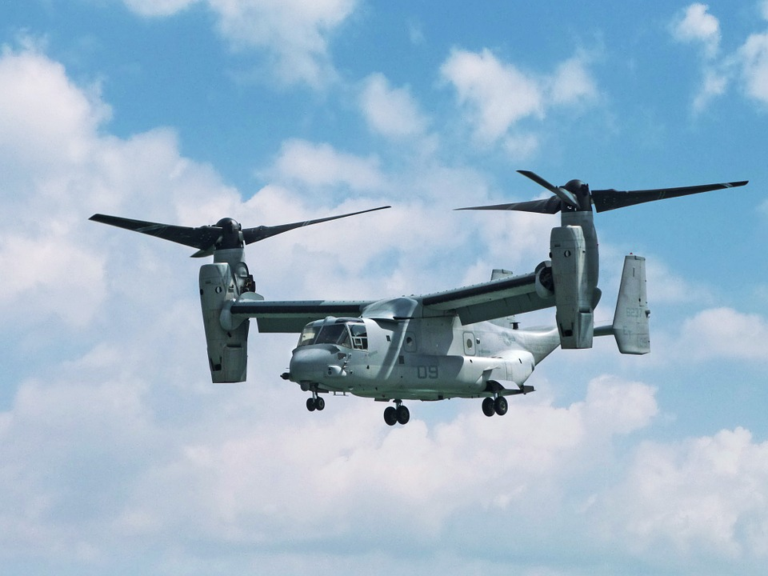
Introduction
Propellers are generally open (unshrouded) rotating bladed devices. They have been used extensively from the 1940’s for efficient propulsion.

Slide 5
Introduction
The most important sources of noise for a propeller are:
Thickness noise → Volume displacement of the blades
Loading noise → Circumferential non-uniform loading (rotation)
Unsteady loading → Inflow angle or inaccuracies in the blade pitch
Quadrupole noise → Nonlinearities due to wake interaction
Broadband noise → Rotating boundary layer in blade edge
Installation noise → Interaction of wakes with surrounding structures

Slide 6
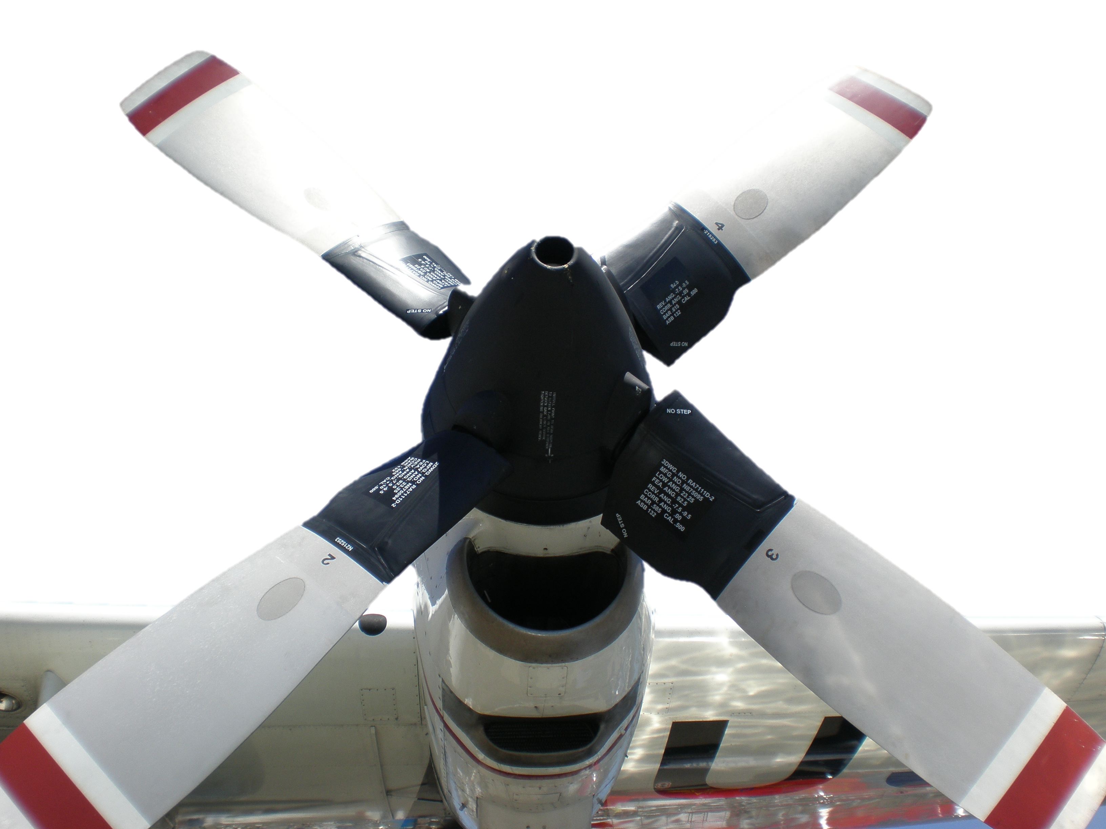
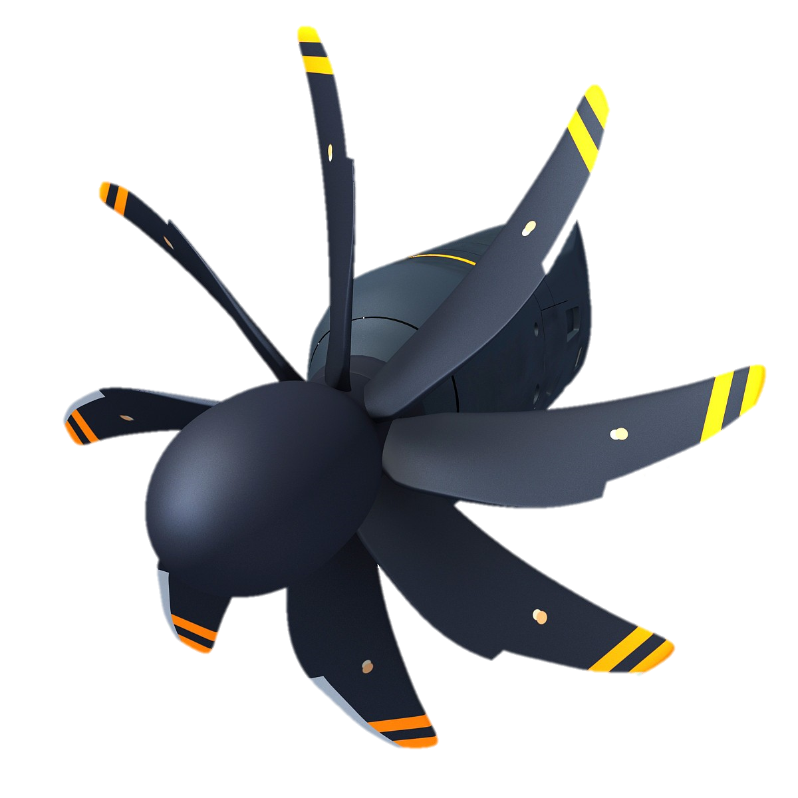
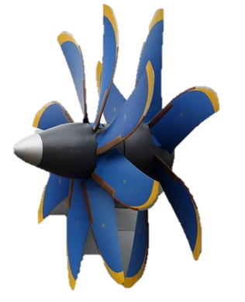
Introduction
Aircraft applications, general configurations:
Single propellers:
Few straight narrow blades
High-performance → small velocity increase to large amount
Moderate flight speed and subsonic rotation regime
Propfan propulsion
High subsonic speed propellers
Increase in speed compensated by swept blades
Efficiency losses are compensated by number of blades
Counter-rotating propfan
High subsonic cruise speed
Recovering of swirl by second rotor/stator
Increase in noise due to slipstream interaction

Slide 7
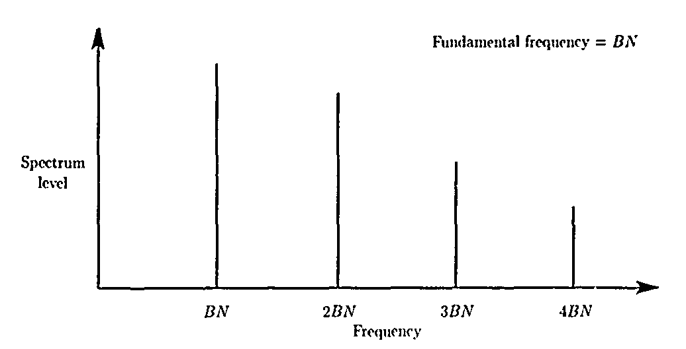
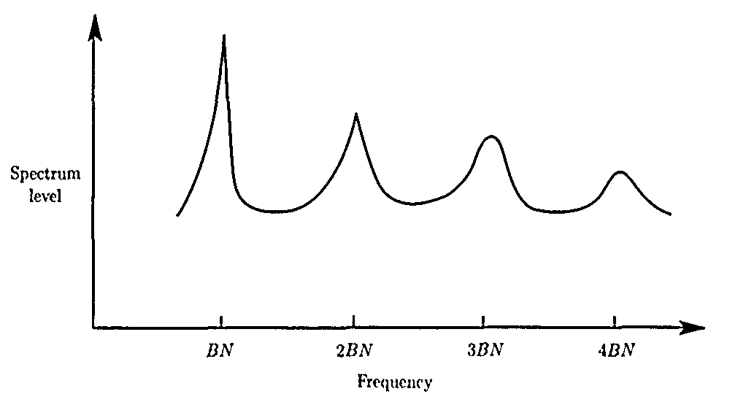
Introduction
Propeller noise can be divided into:
Harmonic noise
Broadband noise
Narrow-band random noise
Harmonic noise
For a propeller running at N[rpm] with B blades:
The fundamental frequency is NxB
Blade passage is at 1/(NxB)
Several harmonics are present
Broadband noise
All frequencies and characteristics, similar to TBL-TE noise
Narrow-band random noise
The energy is spread out in different frequencies
Still with a periodic footprint

Slide 8
Steady sources of noise
Steady sources are constant with respect to “an observer moving with the blade”
Linear thickness
Linear loading
(Non-linear) quadrupole
Linear thickness → monopole distribution, important at high speeds !!!
Transverse periodic displacement of the air by the volume of a passing element
Dependent to blade volume and airfoil shape:
Frequencies function of → blade cross-section
rotational speeds
Loading noise
Thrust and torque → important at moderate speeds, dipoles
Quadrupoles
At high speeds, especially at transonic and for swept blades, high-tip-speed propellers and helicopter rotors.

Slide 9
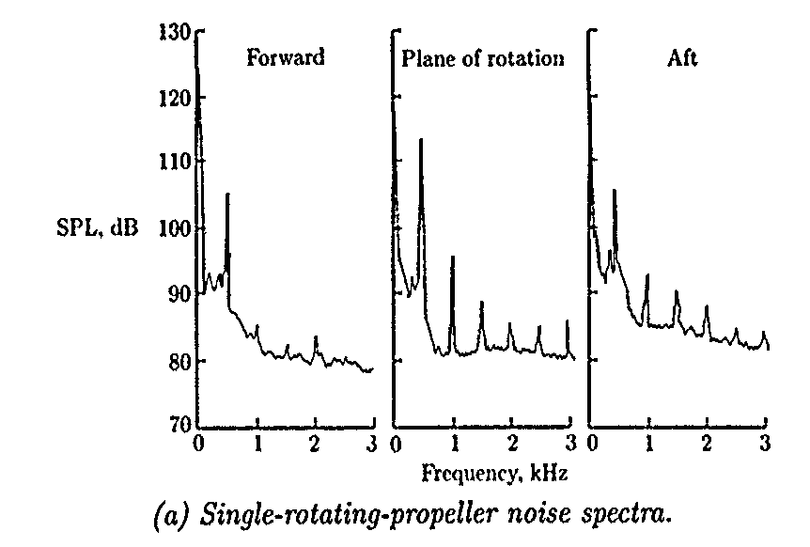
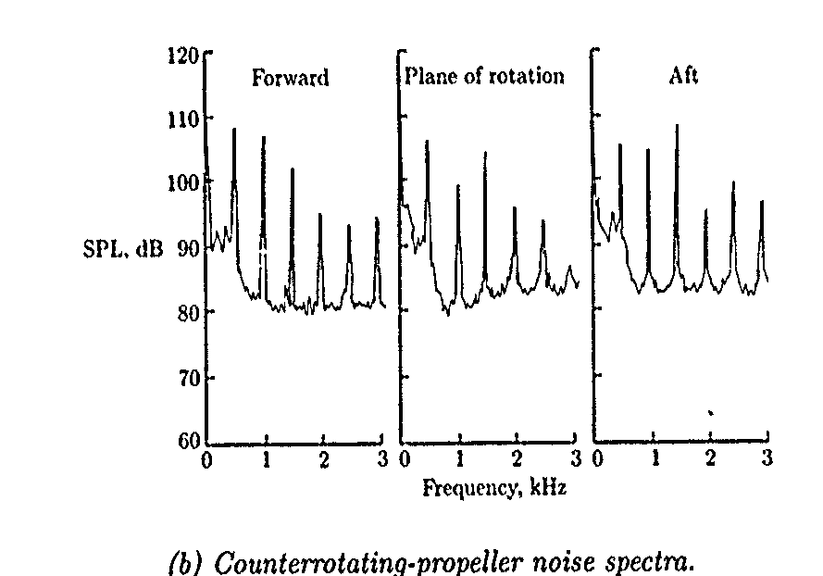
Unsteady and random sources of noise
Unsteady sources are time dependent in “the rotating frame of reference of the blade”
Periodic and random variation of loading of the blades:
Inflow angle, seen as periodic change of angle of attack
Unsteady sources in the blades (blades pitch mismatch)
In contra-rotating propellers → interaction
Potential fields due to inlets or wings
Random sources of noise in propellers are sources of broadband noise:
Inflow turbulence and interaction with the blade
Turbulent boundary-layer trailing-edge noise

Slide 10
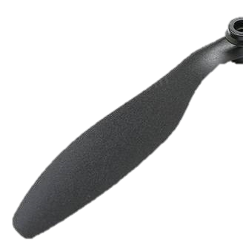
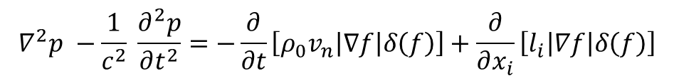
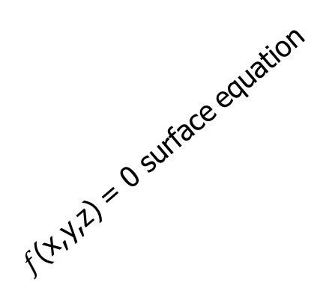
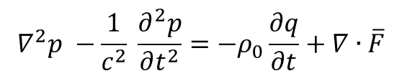
Harmonic noise prediction
Farassat modified Ffowcs Williams and Hawkings equation to account for surfaces in motion in a fluid:
Local velocity of the surface normal to it
i-component of the surface force
Dirac delta function
$$∇^{2}p −\frac{1}{c^{2}} \frac{∂^{2}p}{∂t^{2}}=−\frac{∂}{∂t}\left[{ρ_{0}v}_{n}\left|∇f\right|δ\left(f\right)\right]+\frac{∂}{∂x_{i}}\left[l_{i}\left|∇f\right|δ\left(f\right)\right]$$
ω
Wave operator on pressure p
Contribution due to loading noise
Contribution due to thickness noise
R force {.., l_{i},..}
General form
v_{s}
n(surf)
$f$(x,y,z) = 0 surface equation
$$∇^{2}p −\frac{1}{c^{2}} \frac{∂^{2}p}{∂t^{2}}=−ρ_{0}\frac{∂q}{∂t}+∇∙\overline{F}$$
v_{t}
v_{n}

Slide 11
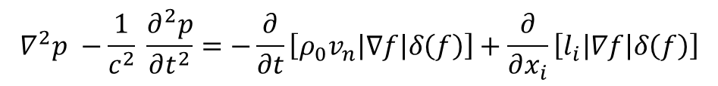
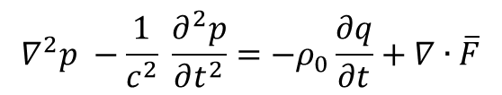
Harmonic noise prediction
$$∇^{2}p −\frac{1}{c^{2}} \frac{∂^{2}p}{∂t^{2}}=−\frac{∂}{∂t}\left[{ρ_{0}v}_{n}\left|∇f\right|δ\left(f\right)\right]+\frac{∂}{∂x_{i}}\left[l_{i}\left|∇f\right|δ\left(f\right)\right]$$
$$∇^{2}p −\frac{1}{c^{2}} \frac{∂^{2}p}{∂t^{2}}=−ρ_{0}\frac{∂q}{∂t}+∇∙\overline{F}$$
Contribution due to thickness noise → sources and sinks of strength q
Contribution due to loading → doublets associated with F vector
Blade section at angle of attack
Noise footprint
Contribution of sources and sinks
Thickness noise
x
x
x
+
As previously explained the solution can be found in:
the time domain
the frequency domain
Contribution due to loading
Vortical distribution

Slide 12
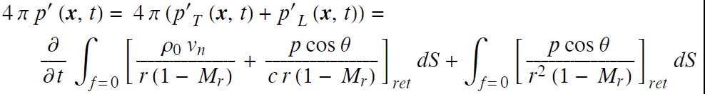
Harmonic noise prediction
Time solutions of the equation are listed by Farassat (1, 1A, 2, 3).
The most important formulations are listed in:
Aircraft Noise Prediction Program ANOPP
Farassat-Padula Advanced Turboprop Prediction (DFP-ATP)
The procedure of solution is similar to the one of FWH, by employing Green function in 3D space.
Contribution consisting of two components: thickness and loading
Important parameters:
ret: retarded time
M_{r}: relative Mach number
c: speed of sound
Other formulations, example 1A isolate near and far-field contributions or account for supersonic effects (e.g. 3)

Slide 13
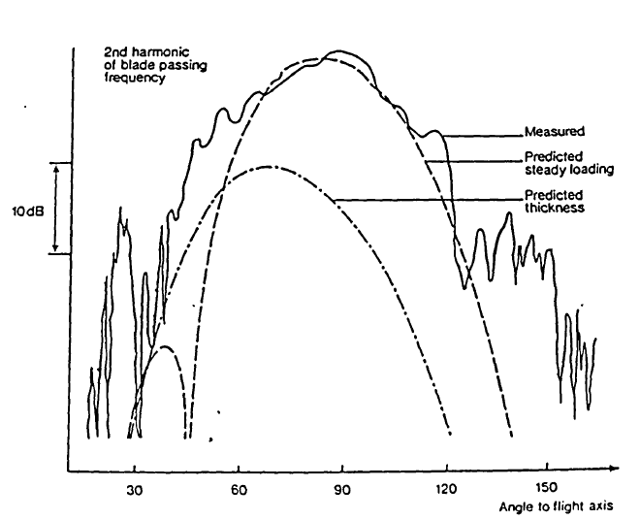
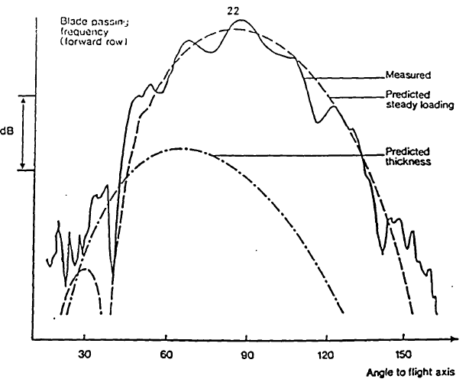
Harmonic noise prediction
Other solutions of the integral have been proposed by Hanson in the frequency domain employing Bessel functions for propagation of the single components.
Comparison with experimental data provided for the Gannet propeller (Rolls Royce)

Slide 14
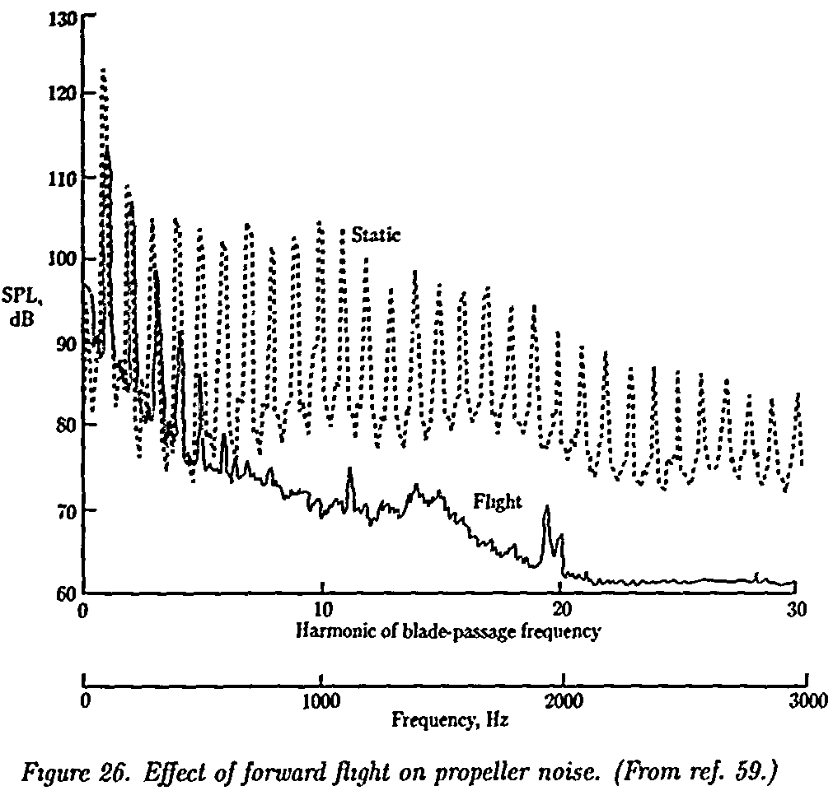
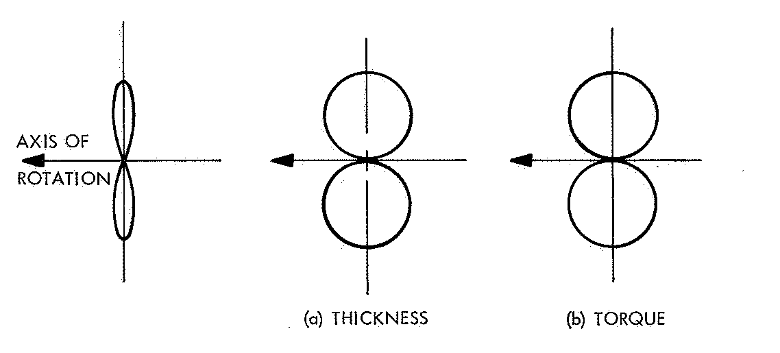
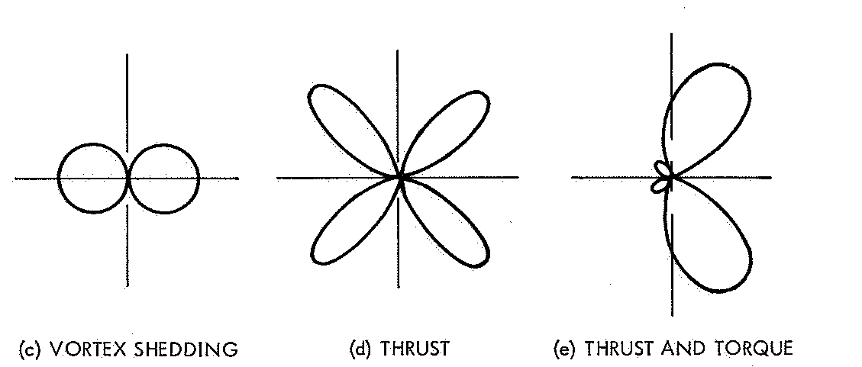
Harmonic noise prediction
Beside the different there is a huge difference between propellers in steady conditions and during flight.
Most of the non-uniformities get attenuated with some inflow speed
Directivity also plays a role
Magliozzi et al. 1977

Slide 15
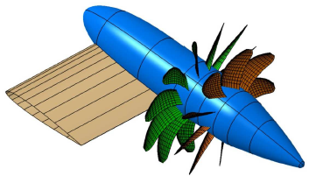
Extension to contra rotating configurations
The harmonic noise prediction can be extended to more complex configurations.
Example: Counter Rotating Propellers in pusher configuration (Jaouani et al. 2015)
Observation
Isolated CRP → interaction noise by wake impingement, dominant component
Hp: viscous effects neglected
propagation effects neglected
We know how to calculate the contribution from a single rotor, how can we treat the interaction?

Slide 16
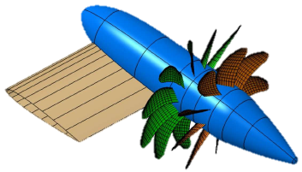
Extension to contra rotating configurations
Separation of the interactions:
Wing wake
Interaction N1:
Rotor 1 wake
Rotor 1 wake
Interaction N2:
Rotor 2 wake
Rotor 1
Wing
Rotor 2
Interactions are split in considering the dominant effect of the wing wake on the upstream rotor.
The effect of the wing wake on the downstream rotor is considered minor.

Slide 17
Extension to counter rotating configurations
Interaction N1:
Option 1
The wing → a propeller with one blade and ω = 0 [rad/s]
Advantage
The system wing/front-rotor can be seen as a doublet generating an interaction noise equivalent to N2 (rotor-rotor) interaction.
Disadvantage
The procedure predicts only the loading noise contribution.
Option 2
The wing is removed → its wake becomes a non-homogeneous inflow conditions
Hanson and Parzych formulation can be used, separating again between loading and thickness
noise.

Slide 18
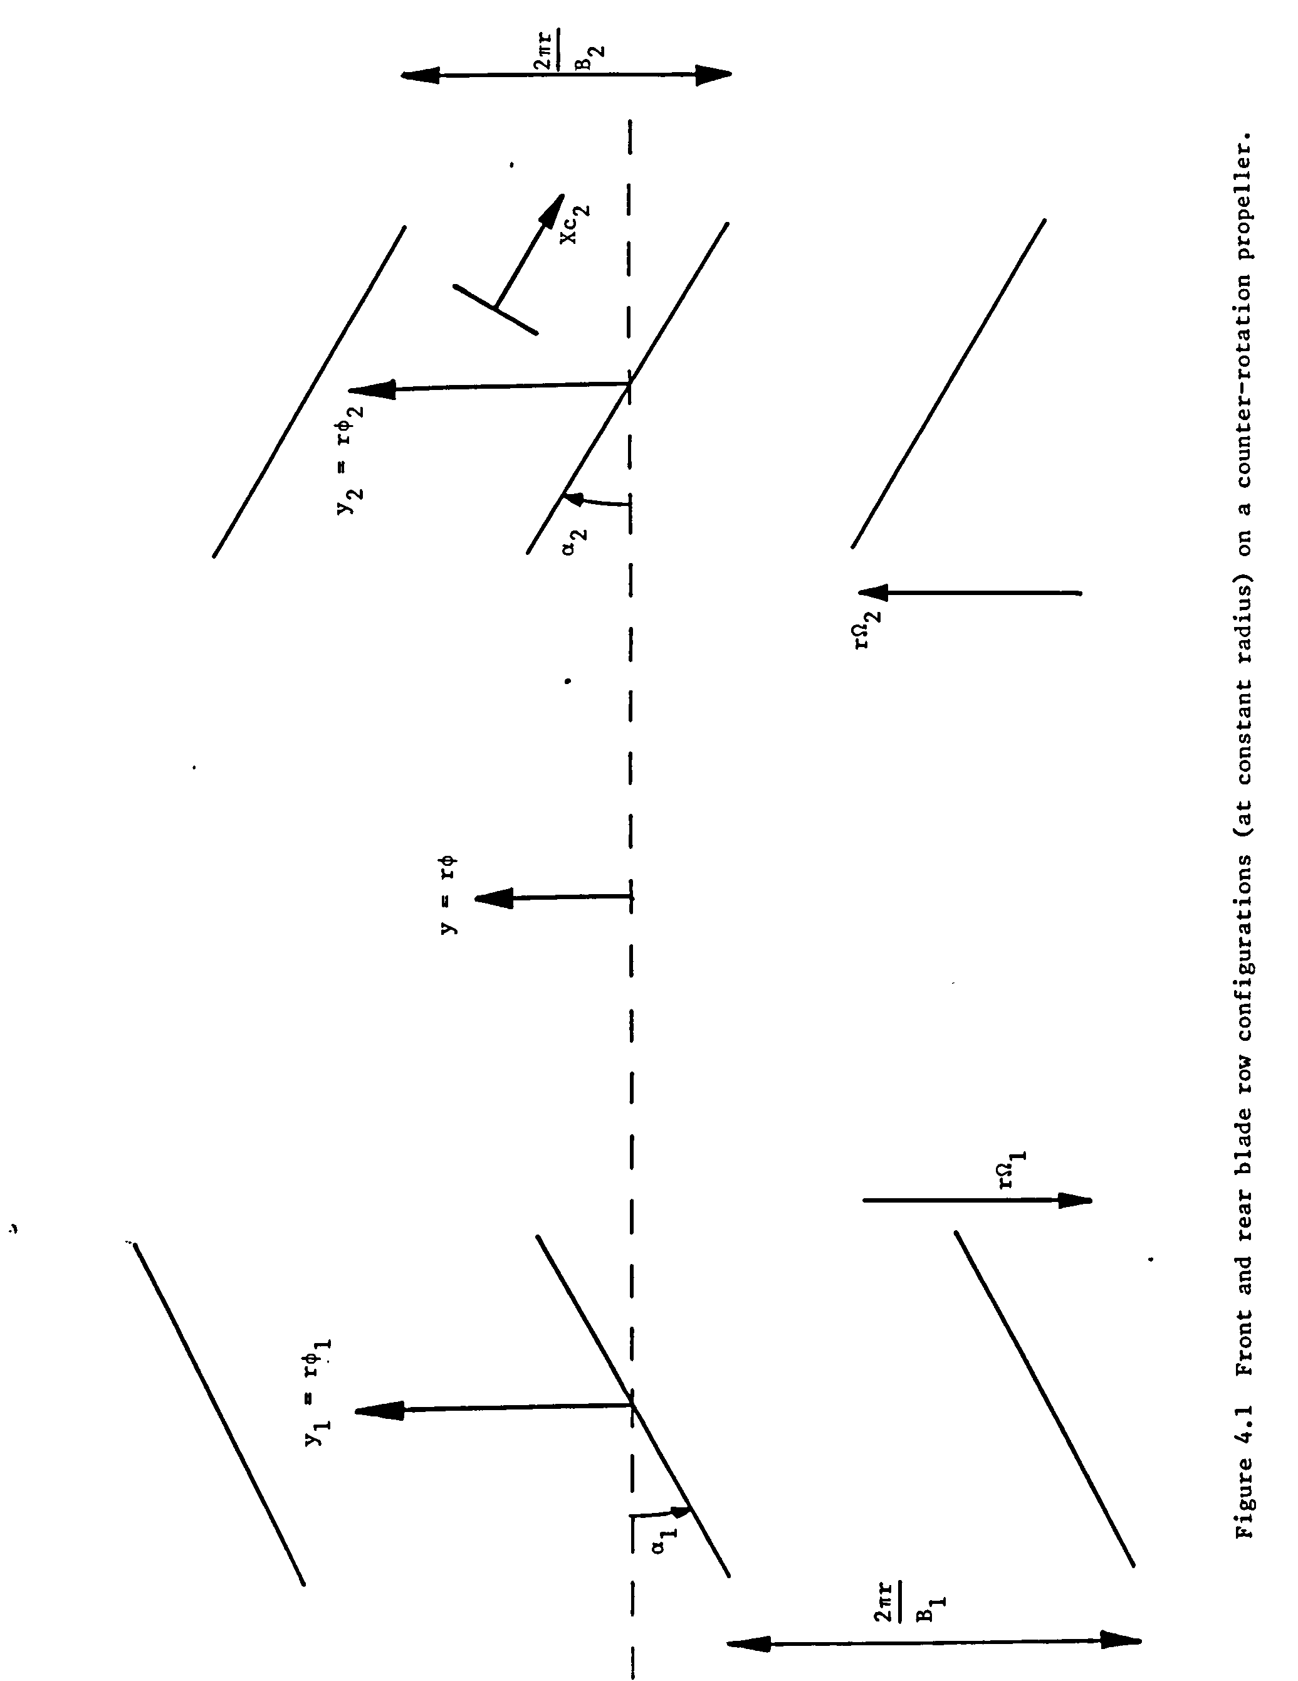
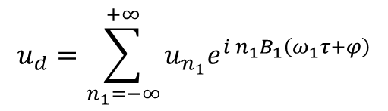
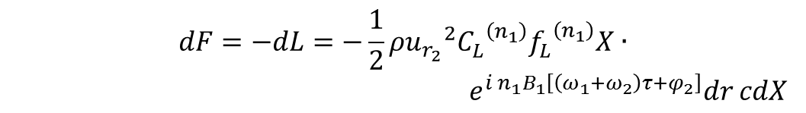
Extension to contra rotating configurations
Therefore the problem can be generalized by discussing the interaction between a downstream blade row and the flow generated by the upstream blade row
Step 1:
Distorted velocity field downstream of the first row
$$u_{d}=\sum_{n_{1}=−∞}^{+∞}{u_{n_{1}}e^{i{ n}_{1}B_{1}\left(ω_{1}τ+φ\right)}}$$
V∞
N.B. retarded time
Step 2:
The distorted velocity generate an unsteady force on the downstream propeller
$$dF=−dL=−\frac{1}{2}ρ{u_{r_{2}}^{}}^{2}{C_{L}^{}}^{\left(n_{1}\right)}{f_{L}^{}}^{\left(n_{1}\right)}X∙$$
$e^{i{ n}_{1}B_{1}\left[\left(ω_{1}+ω_{2}\right)τ+φ_{2}\right]}dr cdX$
Upstream R1
Downstream R2
Shape function
Chord-based element

Slide 19
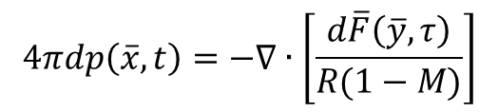
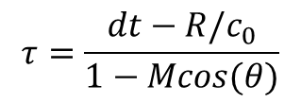
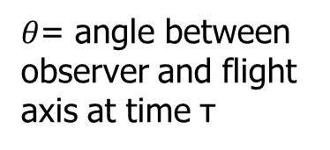
Extension to contra rotating configurations
Therefore the problem can be generalized by discussing the interaction between a downstream blade row and the flow generated by the upstream blade row
Step 3:
We can now use the acoustic pressure due to a moving point force FWH equation
$$4πdp\left(\overline{x},t\right)=−∇∙\left[\frac{d\overline{F}\left(\overline{y},τ\right)}{R(1−M)}\right]$$
V∞
$$τ=\frac{dt−R/c_{0}}{1−Mcos(θ)}$$
$θ$= angle between observer and flight axis at time τ
Step 4:
The far field solution of the blade loading can be found by integration of dp in the far field.
Upstream R1
Downstream R2

Slide 20
Extension to contra rotating configurations
Therefore the problem can be generalized by discussing the interaction between a downstream blade row and the flow generated by the upstream blade row
Step 5:
We still miss the contribution due to the impingement of the wakes of the first rotor on the second one.
The modelling is quite complicated and usually carried out with:
Prandtl’s Wake Model → u’~X^{-1/2}
Schlichting Wake Model (wake width b) → prop. to C_{D} (drag coeff.) and chord
Gaussian Wake Model → model for the velocity distribution, exponential form
The models are propagated as change in velocity again similarly to step 3!
V∞
Upstream R1
Downstream R2

Slide 21
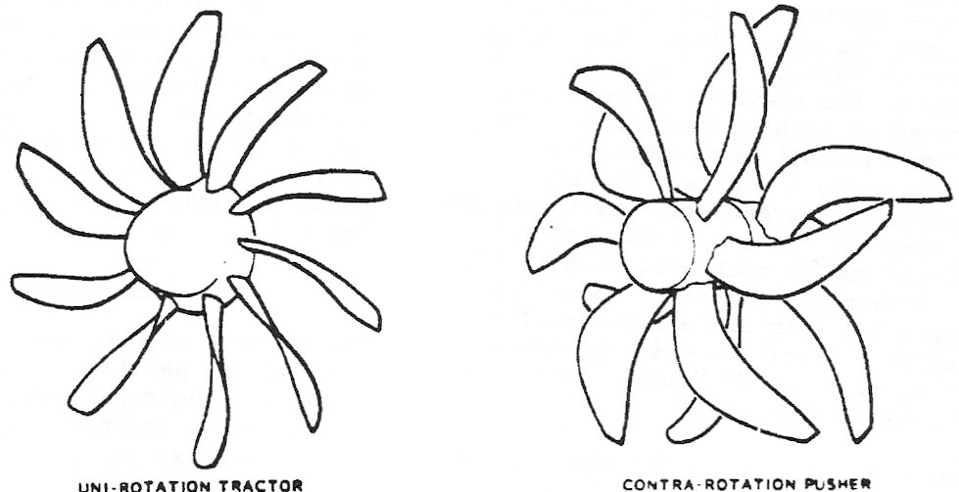
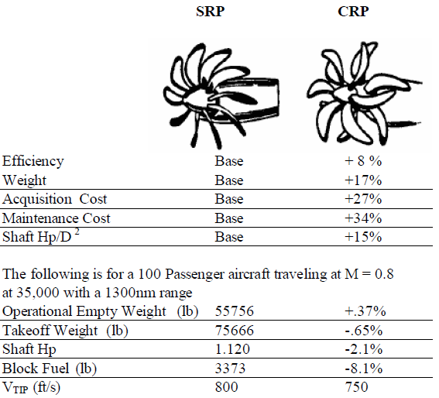
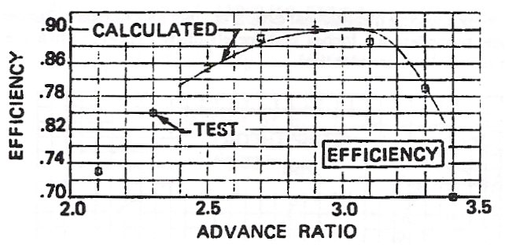
Experimental examples
Experimental overview, Vanderover and Visser:
Single Rotating Propeller SRP
Contra Rotating Propeller

Slide 22
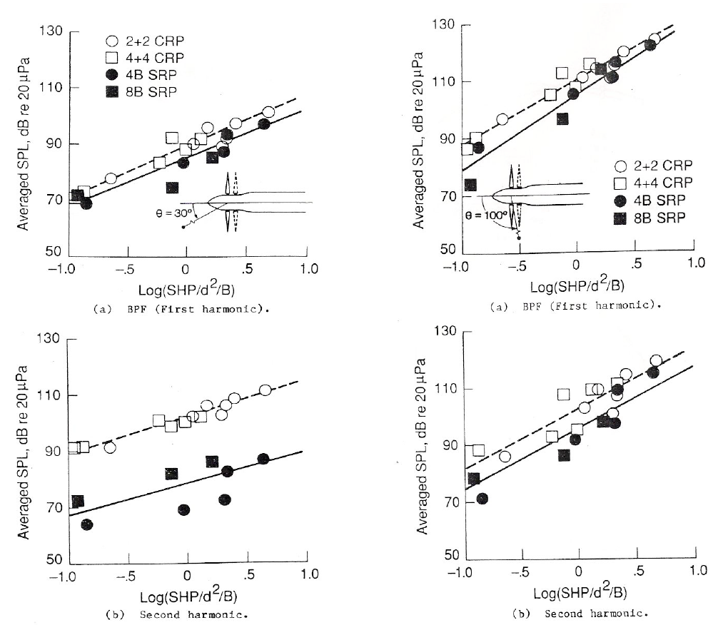
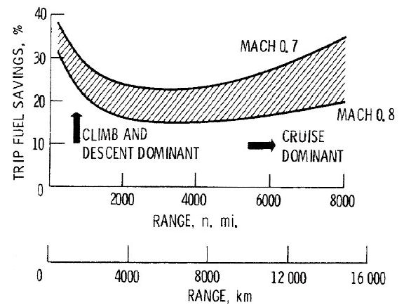
Experimental examples
Experimental overview, Vanderover and Visser:
Single Rotating Propeller SRP
Contra Rotating Propeller

